Slide 1

Linear Time Suffix Array Construction Using D-Critical Substrings
Ge Nong, Sun Yat-sen Univ.
Sen Zhang, SUNY College at Oneonta
Wai Hong Chan, Hong Kong Baptist Univ.

Slide 2

Talk outline
Background
Existing linear SA algorithms
Our linear SA algorithm
Performance evaluation

Slide 3
SA and its applications
Proposed by Manber and Myers in SODA’90
Given a size-n string S with a unique and lexicographically smallest sentinel $ at the end, the suffix starting at S[i] is the substring S[i...n-1], for i ∈ [0, n-1]
The suffix array (SA) of S is the index array of all suffixes sorted in their increasing/decreasing lexicographical order

Slide 4
An example
S = mississippi$
Index | Suffix
0 | mississippi$
1 | ississippi$
2 | ssissippi$
3 | sissippi$
4 | issippi$
5 | ssippi$
6 | sippi$
7 | ippi$
8 | ppi$
9 | pi$
10 | i$
11 | $
Index | Suffix
11 | $
10 | i$
7 | ippi$
4 | issippi$
1 | ississippi$
0 | mississippi$
9 | pi$
8 | ppi$
6 | sippi$
3 | sissippi$
5 | ssippi$
2 | ssissippi$

Slide 5
Applications
In general, could play as a space efficient alternative for suffix tree, for example:
  Computing Burrows-Wheeler Transform (BWT) in compression
  Building compact index for pattern alignment/matching in bio-informatics

Slide 6
Existing linear SA algorithms
The current practical linear SA algorithms from others are the KS (Karkkainen, Sanders and Burkhardt) and the KA (Ko and Aluru) algorithms, both adopt the divide-and-conquer methodology
KA has a better performance, but KS is simpler and more elegant in design

Slide 7
Motivation
Motivation: to have a linear algorithm for SA construction that has
  A better time/space performance than the KA algorithm;
  A simple design comparable to that of the KS algorithm; and
  A capability to use external memory (e.g., harddisk) for computing huge SAs.

Slide 8
Our algorithm
A recursive divide-and-conquer procedure consists of two linear components:
  Problem reduction: reducing the problem by sampling fixed-size d-critical substrings, at a reduction ratio not more than ½;
  Solution induction: inducing the SA at each level from the lower level.
The total time is linear of O(n).

Slide 9
Sorting in our algorithm
Sorting in the algorithm comprises
  Bucket sorting for problem reduction; and
  Induced sorting for solution induction.
Both the bucket and the Induced sortings are linear in time.

Slide 10
Problem reduction
Problem reduction:
  (1) Traverse the string once to find all the fixed-size d-critical substrings, where d>=2 and each substring has a length of d+2 characters;
  (2) Sort all the sampled d-critical substrings;
  Repeat (1) and (2) until there is only one d-critical substring.

Slide 11
Solution induction
Traverse twice in a total time of O(n):
  Traverse once to induced sort all the type-L suffixes from the sorted LMS suffixes;
  Traverse once more to induced sort all the type-S suffixes from the sorted type-L suffixes.

Slide 12
S-type and L-type Characters
S[i] is a S-type character if
S[i..n-1] < S[i+1..n-1]
Otherwise, S[i] is L-type
S[i] is left most S-type character if
S[i] is S-type and S[i-1] is L-type

Slide 13
Example
S: m i s s i s s i p p i $
t: L S L L S L L S L L L S

Slide 14
Assigning d-critical characters
All “left most S-type” characters are d-critical characters
In between any two neighboring d-critical characters, there are at least one but at most d characters

Slide 15
An example for 2-critical substrings
S: m i s s i s s i p p i $
t: L S L L S L L S L L L S
DCS: i s s i
i s s i
i p p i
p i $ $
$ $ $ $
DCS = d-critical substring

Slide 16
Key ideas
There are at most 0.5n d-critical characters/substrings.
If we can sort all the d-critical substrings, we can replace each d-critical substring with its index in the order, i.e. naming, which will produce a shorter string of length not longer than ½ of the original.

Slide 17
Key ideas (cont.)
From the SA of the shortened string, we can compute the SA of the original string in O(n) time by induction.

Slide 18
Sorting d-critical substrings
Sorting all the d-critical substrings can be split into 3 tasks:
  (1) Bucket sort the substrings according to the omega weights of their last characters
  (2) From the result of (1), continue to bucket sort the substrings by their other characters, from the last to the first

Slide 19
Sorting {issi, issi, ippi$, pi$$, $$$$}
$ | $$$$ pi$$ | $$$$ pi$$ | $$$$ | $$$$ | 0
i | ippi issi issi |  | pi$$ | ippi issi issi | 1 2 2
p |  | ippi | ippi | pi$$ | 3
s |  | issi issi | issi issi
omega
weight
sorting
Character
sorting
naming

Slide 20
Reduced string
S: m i s s i s s i p p i $
t: L S L L S L L S L L L S
DCS: i s s i
i s s i
i p p i
p i $ $
$ $ $ $
S1: 2 2 1 3 0

Slide 21
Main Results
Theorem 4: Given S is of a constant or integer alphabet:
  The time complexity is O(n);
  The space complexity is O(nlog(n)) bits.

Slide 22
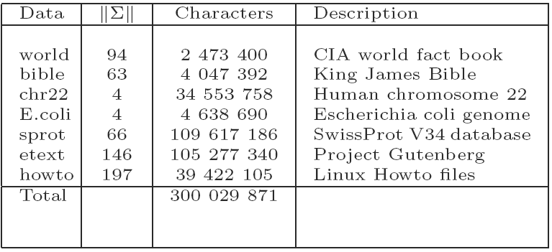
Performance evaluation

Slide 23
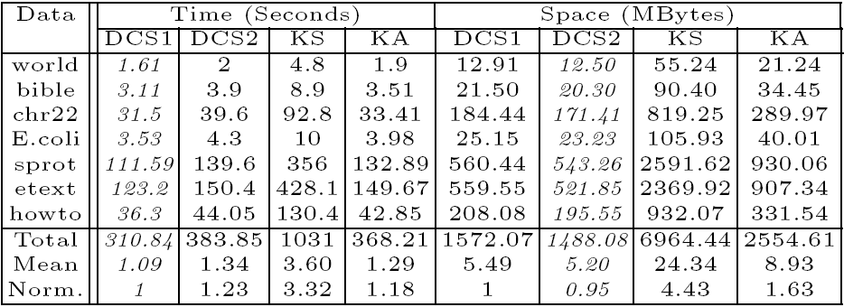
Time and space

Slide 24
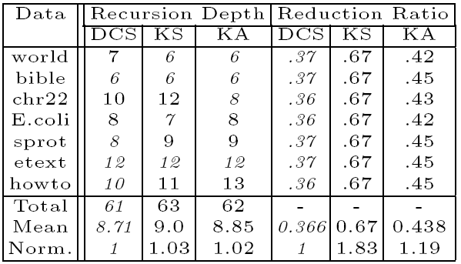
Recursion depth and reduction ratio: smaller and better

Slide 25
Summary
The d-critical sorting algorithm was observed to achieve the better time and space performances than the linear KA and KS algorithms for SA construction
The whole algorithm is coded in around 100-130 effective lines in C++
Sorting the fixed-size d-critical substrings allows the algorithm to use external memory

Slide 26
Thank you!

